Slide 1
LECTURE -9(b)
Logistic Regression
Course Instructor
Engr. Naina Said

Slide 2
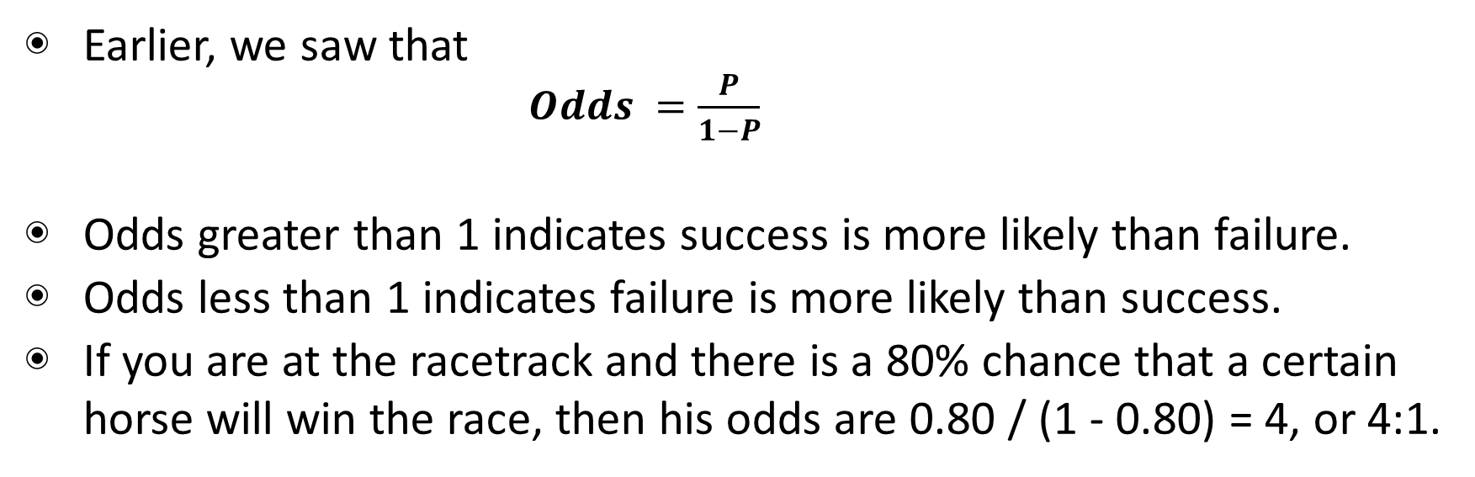
CSE-422: Data Analytics
Odds
Earlier, we saw that
$Odds =\frac{P}{1−P}$
Odds greater than 1 indicates success is more likely than failure.
Odds less than 1 indicates failure is more likely than success.
If you are at the racetrack and there is a 80% chance that a certain horse will win the race, then his odds are 0.80 / (1 - 0.80) = 4, or 4:1.

Slide 3
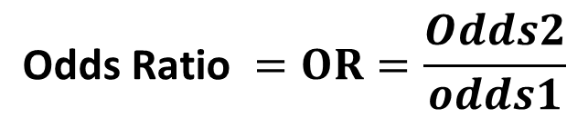
CSE-422: Data Analytics
Odds Ratio
The odds ratio is exactly what it says it is, a ratio of two odds.
A common way to compare two groups is to look at the ratio of their odds.
An odds ratio of exactly 1 means there is no effect on odds.
An odds ratio of more that the odds of event B are higher compared to event A
An odds ratio is less than 1 is associated with lower odds.
$$\text{Odds} \text{Ratio} =OR=\frac{Odds2}{odds1}$$

Slide 4
CSE-422: Data Analytics
Odds Ratio Example
Consider a hypothetical group of smokers and non-smokers. We are interested to find the odds of lung cancer in smokers compared to non smokers
If 17 smokers have lung cancer, 83 smokers do not have lung cancer, one non-smoker has lung cancer, and 99 non-smokers do not have lung cancer, the odds ratio is calculated as follows.

Slide 5
CSE-422: Data Analytics
Odds Ratio Example
Odds in exposed group = (smokers with lung cancer) / (smokers without lung cancer) = 17/83 = 0.205
Odds in not exposed group = (non-smokers with lung cancer) / (non-smokers without lung cancer) = 1/99 = 0.01
Odds ratio = (odds in exposed group) / (odds in not exposed group) = 0.205 / 0.01 = 20.5
Thus using the odds ratio, this hypothetical group of smokers has 20 times the odds of having lung cancer than non-smokers

Slide 6
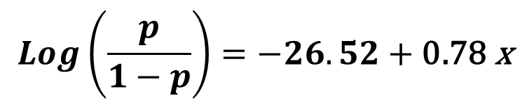
CSE-422: Data Analytics
Odds Ratio In Logistic Regression
Recall the logit function
$$\operatorname{Log}\left(\frac{p}{1−p}\right)=−26.52+\text{0.78} \text{x}$$
Here, a one unit change in x will result in 0.78 increase in the log of ODDS holding all other variables constant.
This interpretation does not make much sense.

Slide 7
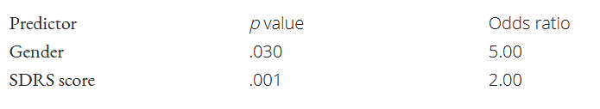
CSE-422: Data Analytics
Odds Ratio In Logistic Regression
The logistic regression analysis also gives results in terms of log ratios.
Consider a researcher who chooses a few predictor variables to assess her chances of being eaten white shark, based on (a) score on the Shark Related Deliciousness Scale (SRDS), and (b) her gender
Consider female is coded as 0 and male is coded as 1.
She performs logistic regression and gets the following results (in terms of log ratio)

Slide 8
CSE-422: Data Analytics
Odds Ratio In Logistic Regression Interpretation
Remember, log ratios are only interpreted when a particular co-efficient is significant i.e. p<0.05
Consider gender
The odd ratio is greater than 1.
This means that as gender “increases,” the odds of being eaten increases.
“Increase” in gender means a gender of 1 instead of 0 – in other words, being male.
Thus, being in the (1) group, or being male, puts you at 5 times greater odds of being eaten.

Slide 9
CSE-422: Data Analytics
Odds Ratio In Logistic Regression Interpretation
Now consider SDRS,
This variable is continuous, the interpretation of the odds ratio is a little different.
For each unit increase in deliciousness score, the odds of being eaten by a shark increase by a factor of 2.
Someone with a score of 2 on the scale is 2 times more likely to be eaten than someone with a score of 1

Slide 10
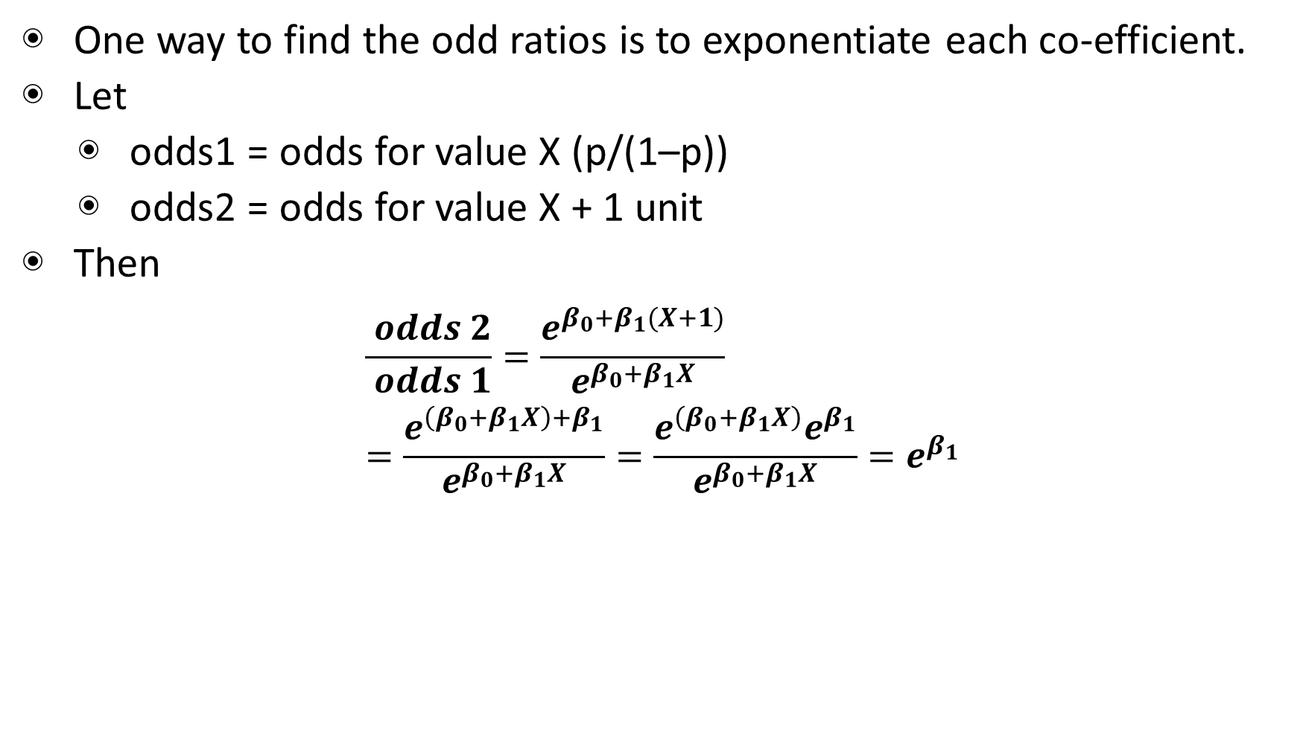
CSE-422: Data Analytics
A simpler way to find the Odd Ratios
One way to find the odd ratios is to exponentiate each co-efficient.
Let
odds1 = odds for value X (p/(1–p))
odds2 = odds for value X + 1 unit
Then
$$\begin{aligned}&\frac{ odds 2}{ odds 1}=\frac{e^{β_{0}+β_{1}(X+1)}}{e^{β_{0}+β_{1}X}} \\ &=\frac{e^{\left(β_{0}+β_{1}X\right)+β_{1}}}{e^{β_{0}+β_{1}X}}=\frac{e^{\left(β_{0}+β_{1}X\right)}e^{β_{1}}}{e^{β_{0}+β_{1}X}}=e^{β_{1}}\end{aligned}$$

Slide 11
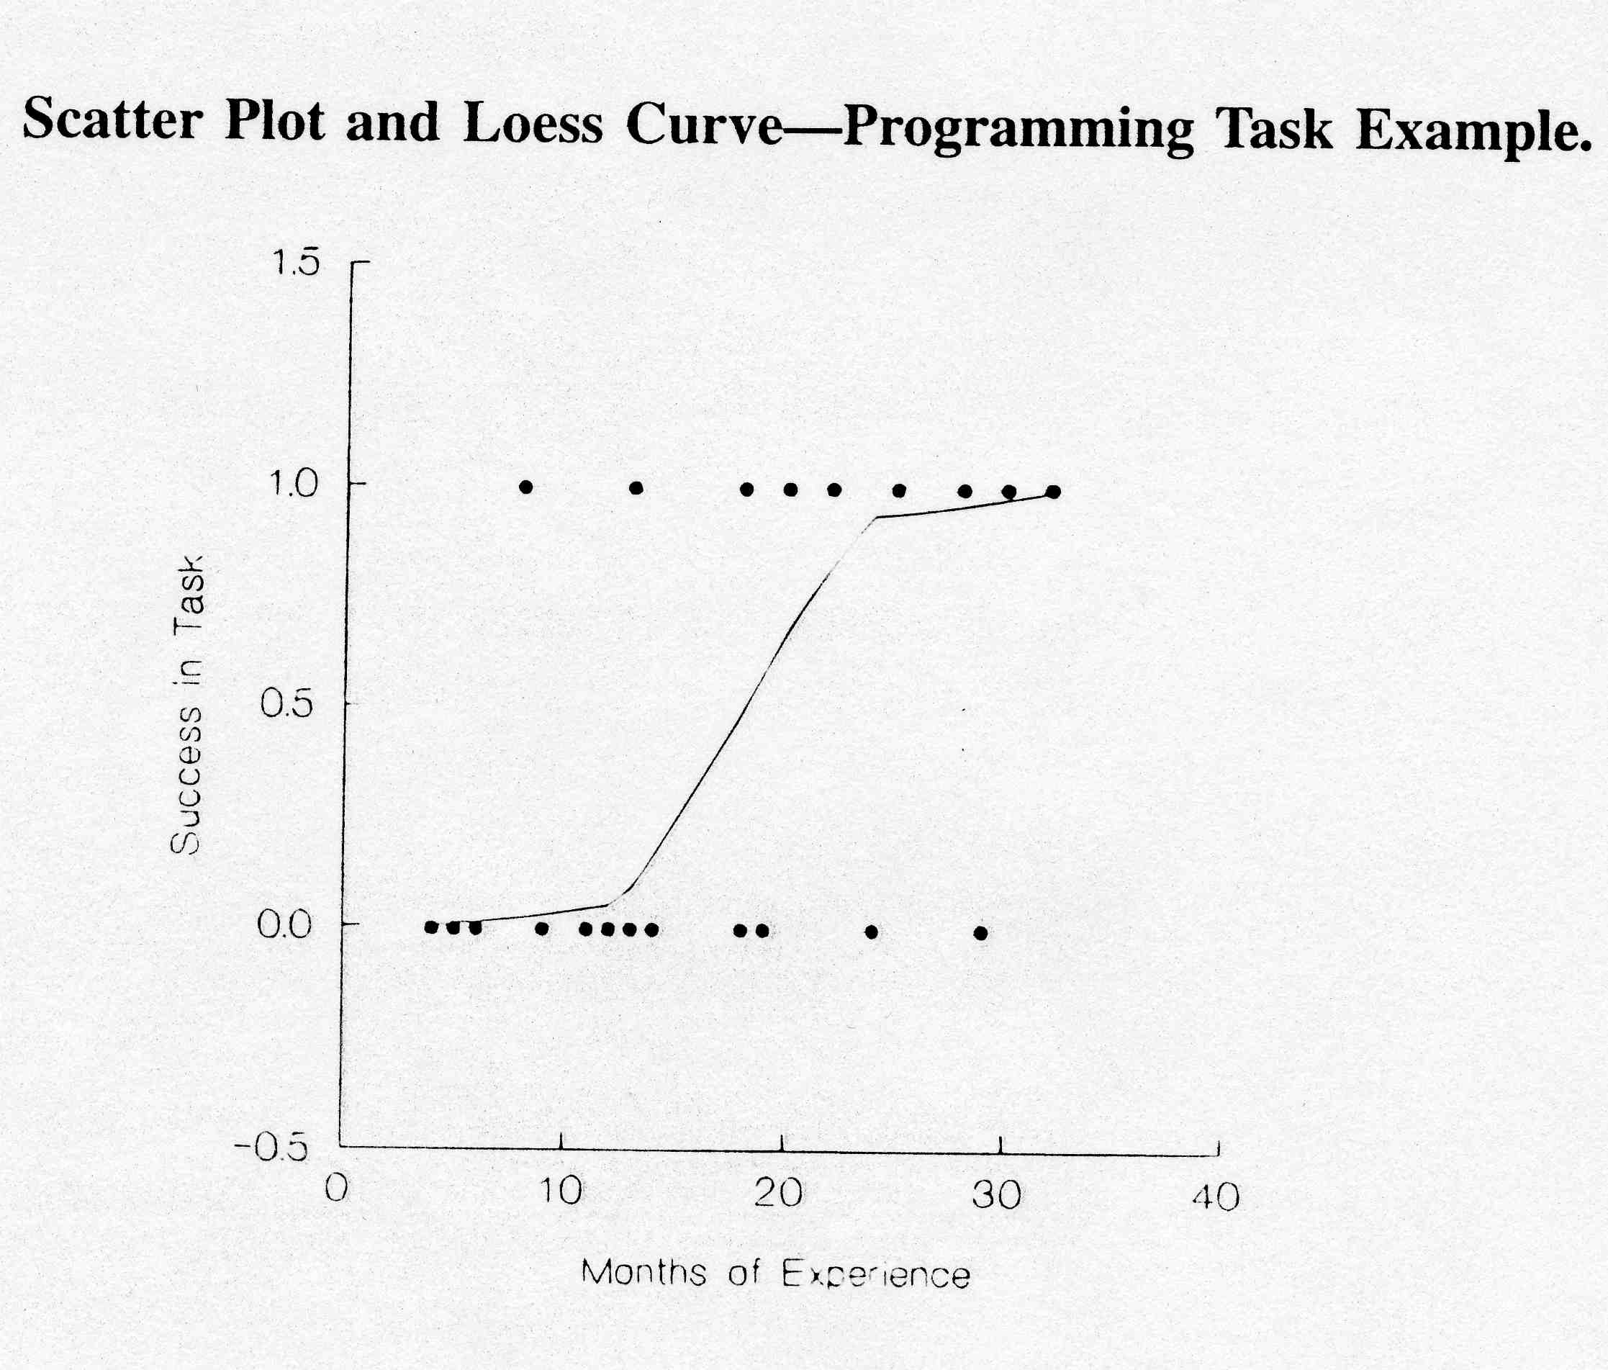
CSE-422: Data Analytics
Example II
A systems analyst studied the effect of computer programming experience on ability to complete a task within a specified time
Twenty-five persons selected for the study, with varying amounts of computer experience (in months)
Results are coded in binary fashion: Y = 1 if task completed successfully; Y = 0, otherwise

Slide 12
CSE-422: Data Analytics
Example II
Results from a standard package give:
β₀ = –3.0597 and β₁ = 0.1615
Estimated logistic regression function:
For example, the fitted value for X = 14 is:
(Estimated probability that a person with 14 months experience will
successfully complete the task)

Slide 13
CSE-422: Data Analytics
Example II
Odds ratio: expβ1 = e^{0.1615} = 1.175
Odds increase by 17.5% with each additional month of experience
A unit increase of one month is quite small, and we might want to know the change in odds for a longer difference in time
For c units of X: exp(cβ1)

Slide 14
CSE-422: Data Analytics
Example II
Suppose we want to compare individuals with relatively little experience to those with extensive experience, say 10 months versus 25 months (c = 15)
Odds ratio: e^{15x0.1615} = 11.3
Odds of completing the task increase 11-fold!

